Slide 1
Comic Generator using GPT2
Submitted By: Surabhi Govil, Gayathri Pulagam, Rishitha Bandi

Slide 2
Objective:
Use GPT2 to generate large texts from text prompt.
Generate image from the story text generated.
Use Vertex AI to do model monitoring and serving.

Slide 3
GPT2:
GPT-2 stands for “Generative Pretrained Transformer 2”
GPT-2 is an open-source artificial intelligence created by OpenAI in February 2019.
The dataset used here is Writing Prompt Dataset by FAIR
Use to generate consistent stories by Hierarchical Neural Story Generation (Fan et al., 2018) https://arxiv.org/abs/1805.04833
GPT2 fine tuned on this dataset to generate large texts

Slide 4
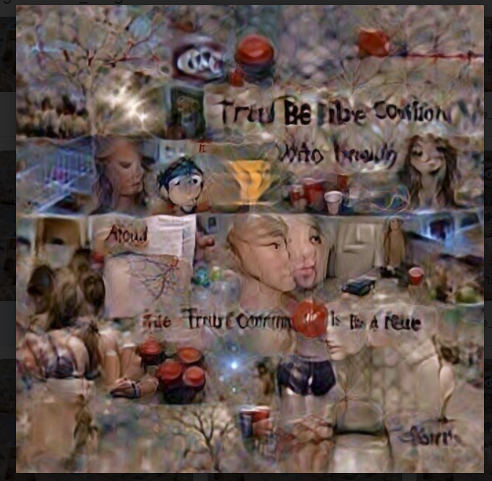
Image Generation:
We trained a CLIP + Siren based model by referencing Deep Daze library for generating images for our generated stories
Deep Daze is an image generation CLI tool for generating images from text
By using the deed daze’s library, we use the imagine generator to generate image story for our generated story

Slide 5
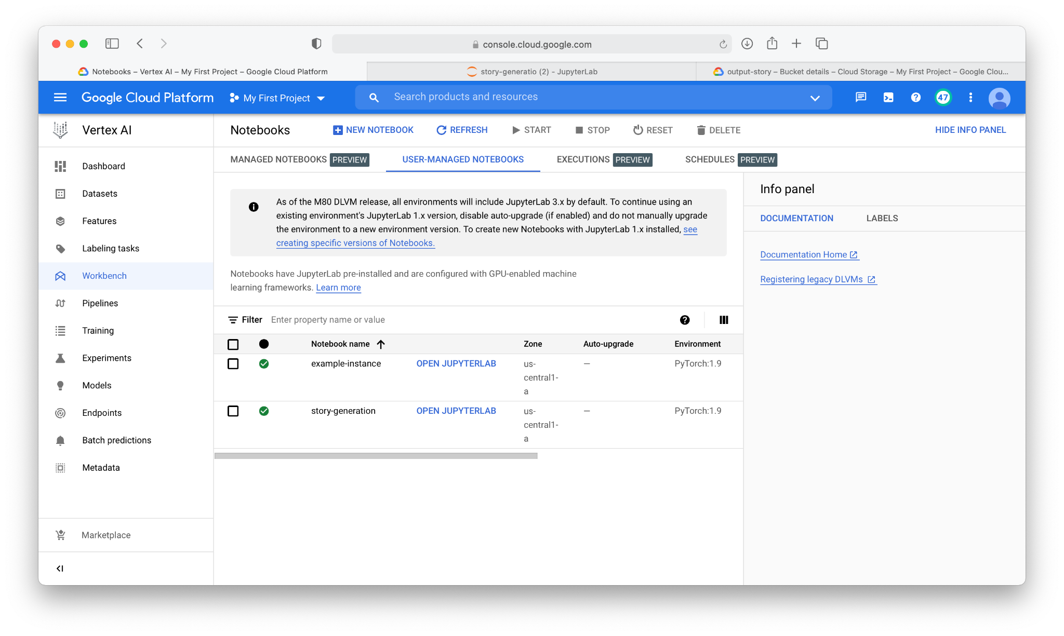
MLOps
Creating pytorch notebook for implementing the end to end MLOps on google vertex AI.

Slide 6
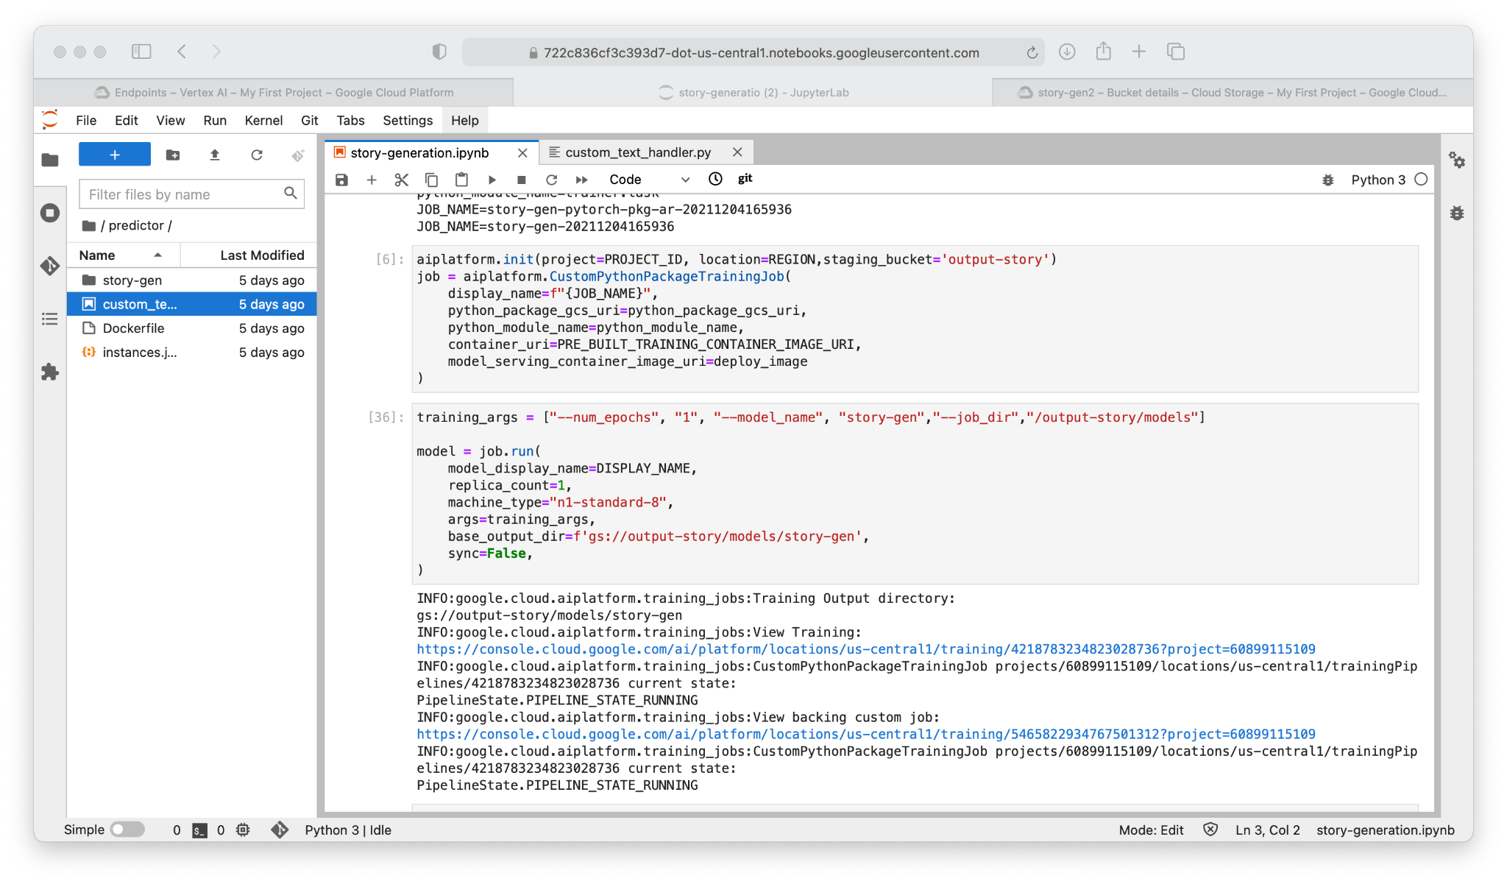
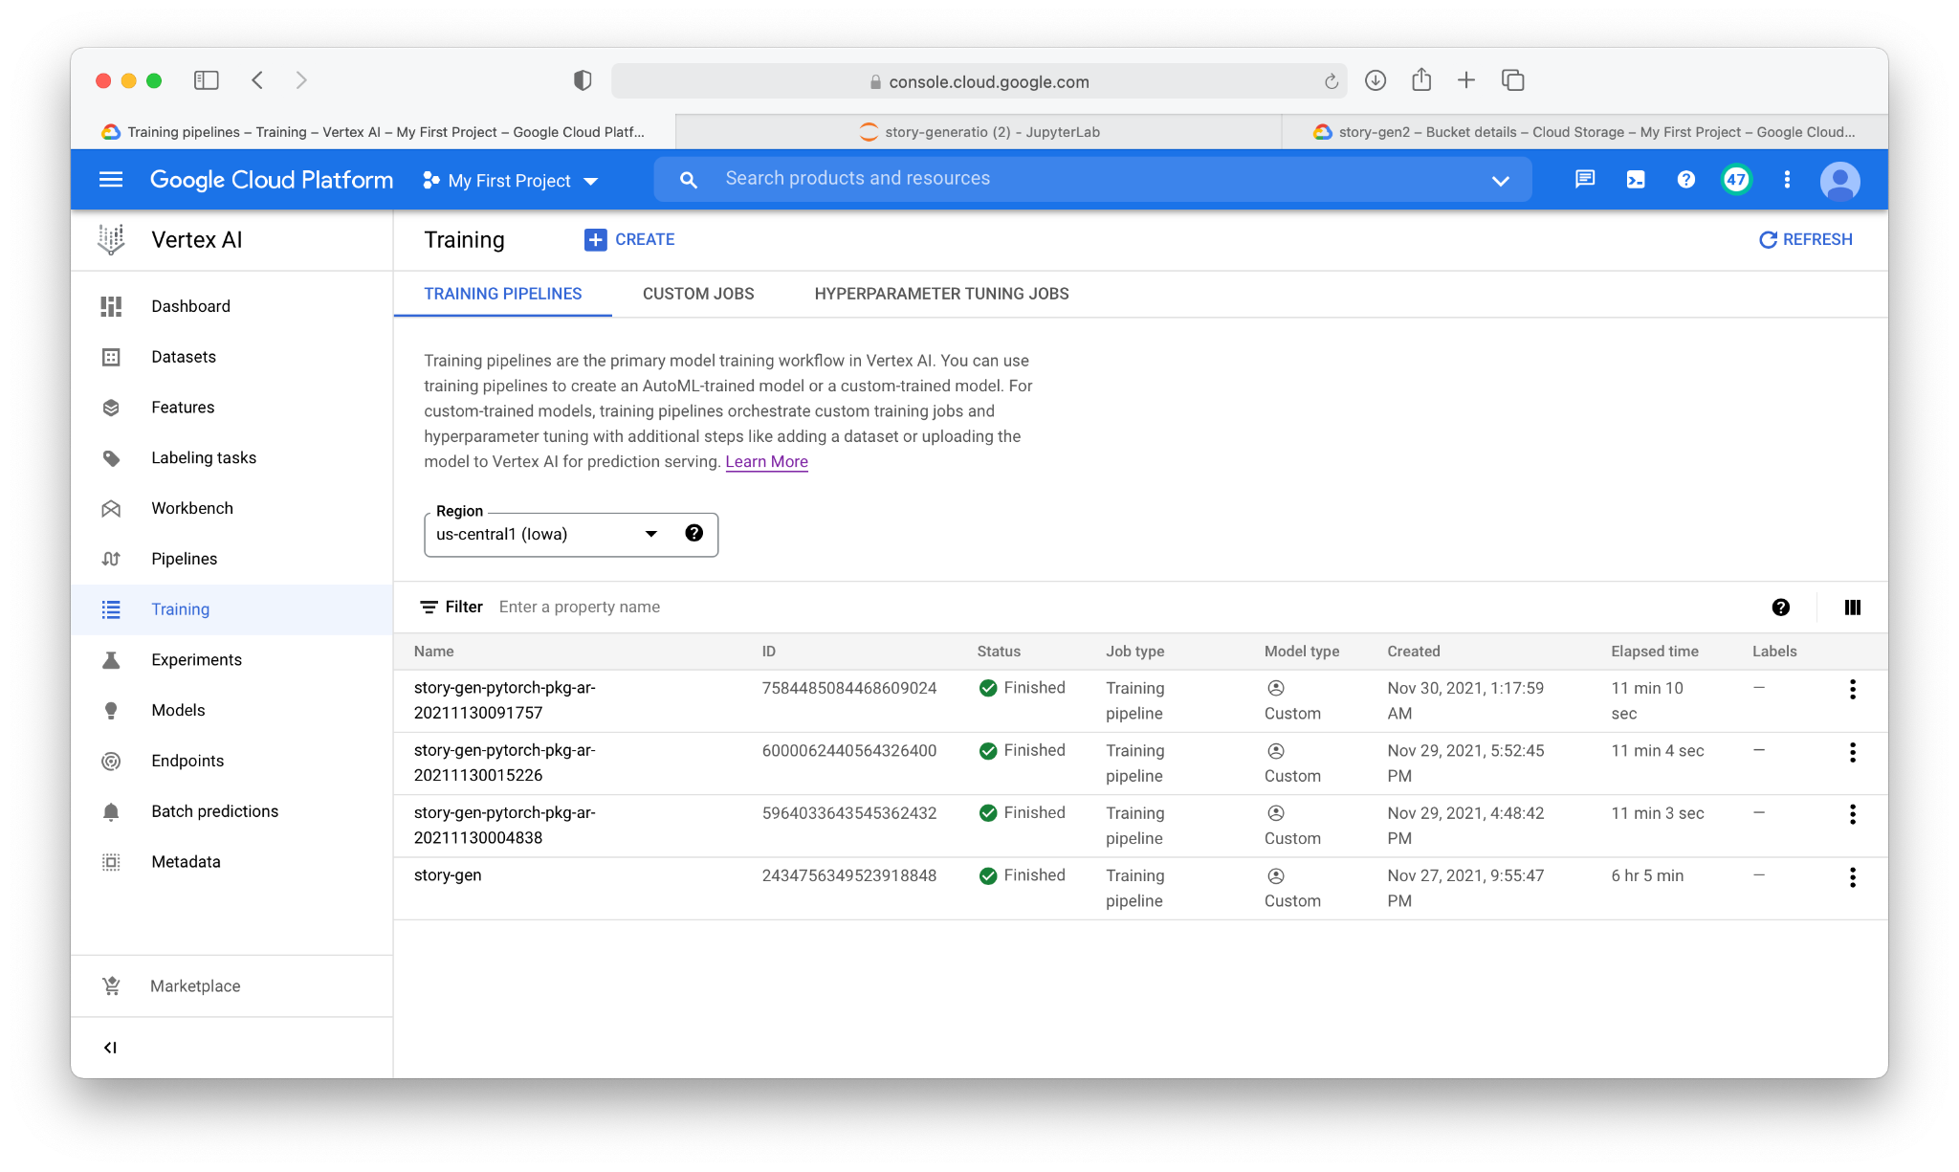
Training
create buckets with dataset, python package and output bucket. Initialize the training job.

Slide 7
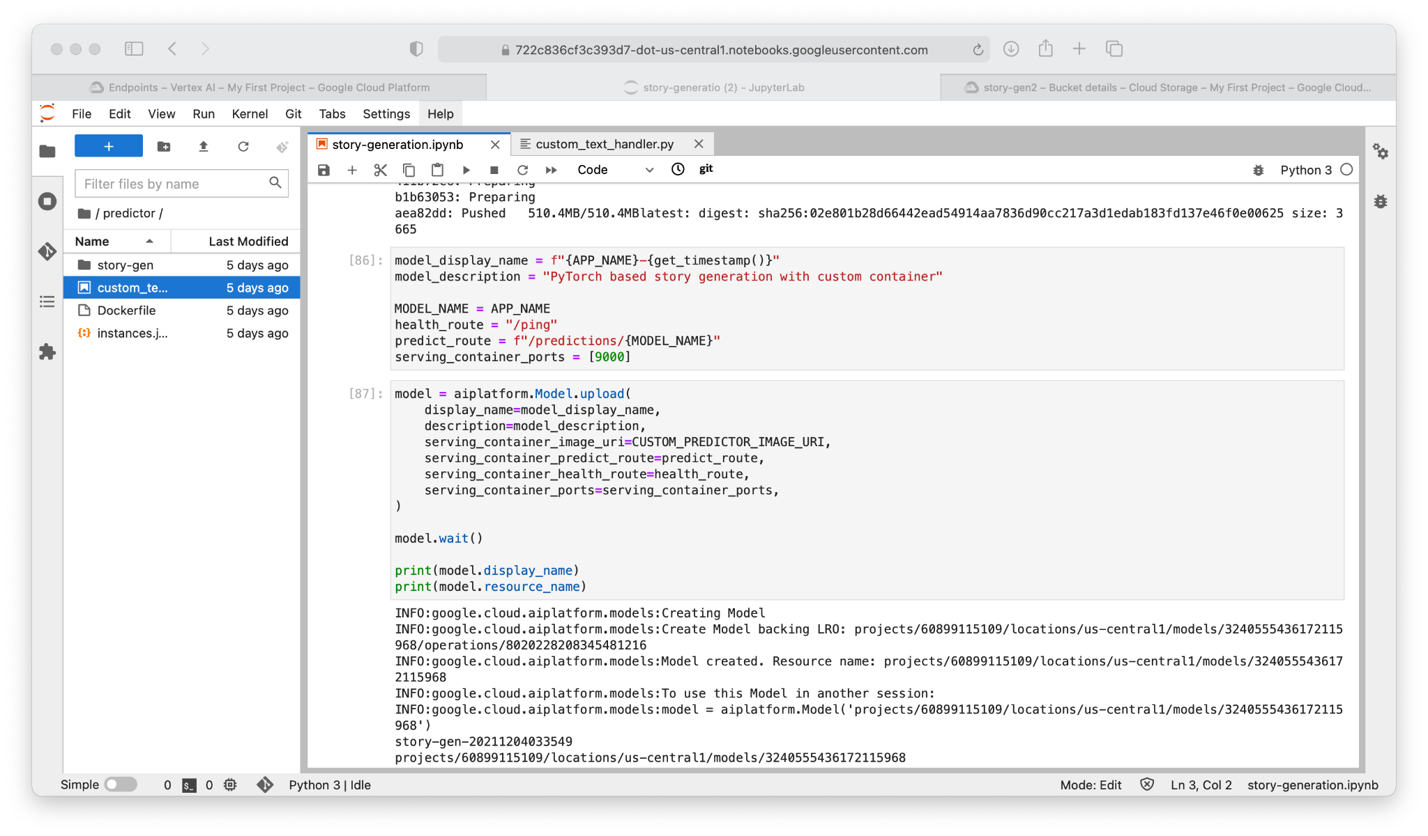
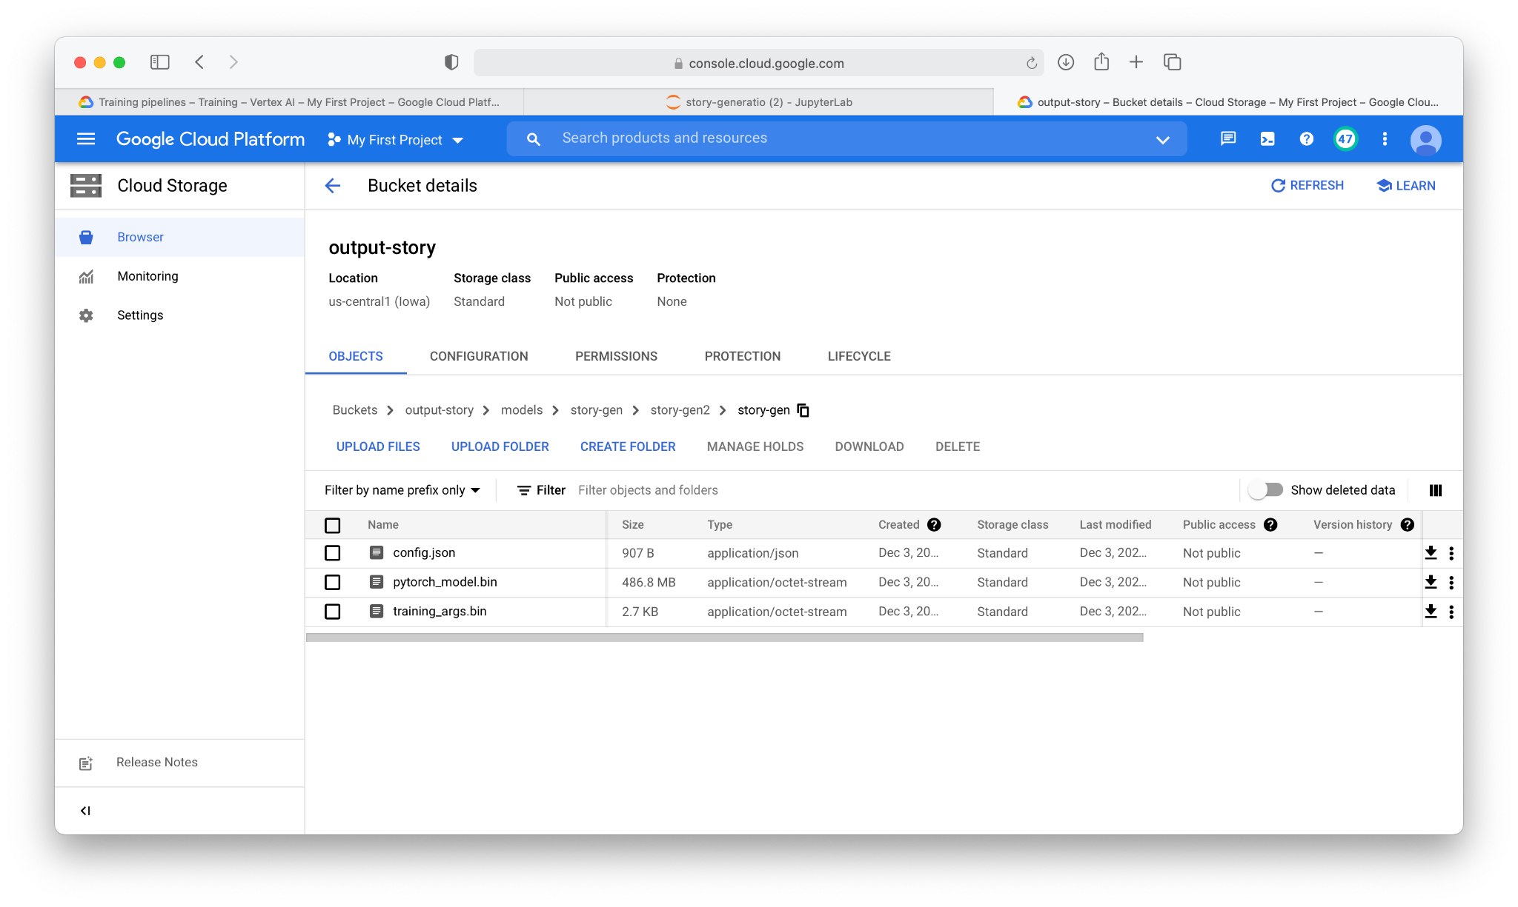
Upload Model
Upload model to the vertex AI. After training model artifacts are saved at the output bucket location specified.

Slide 8
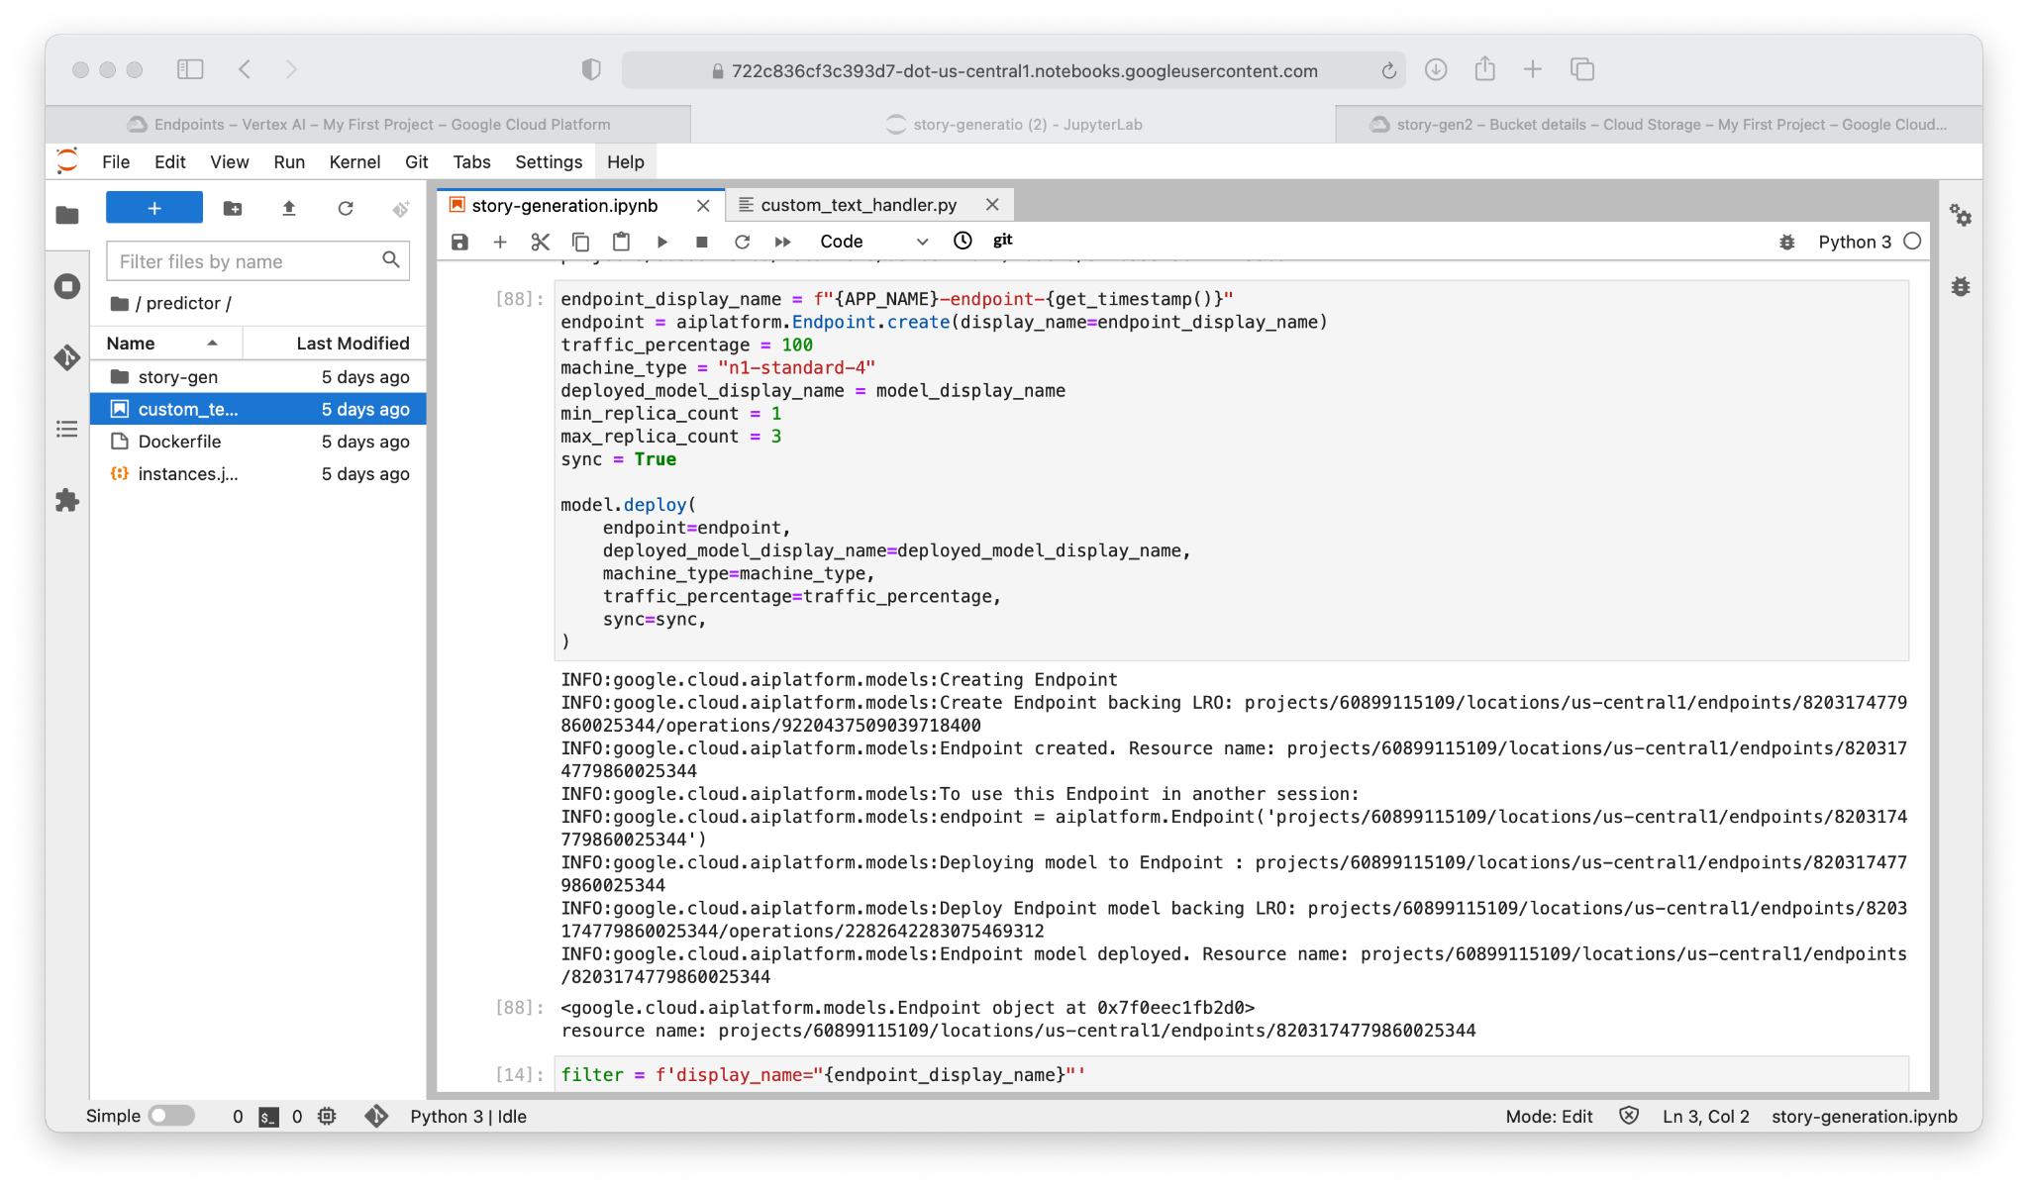
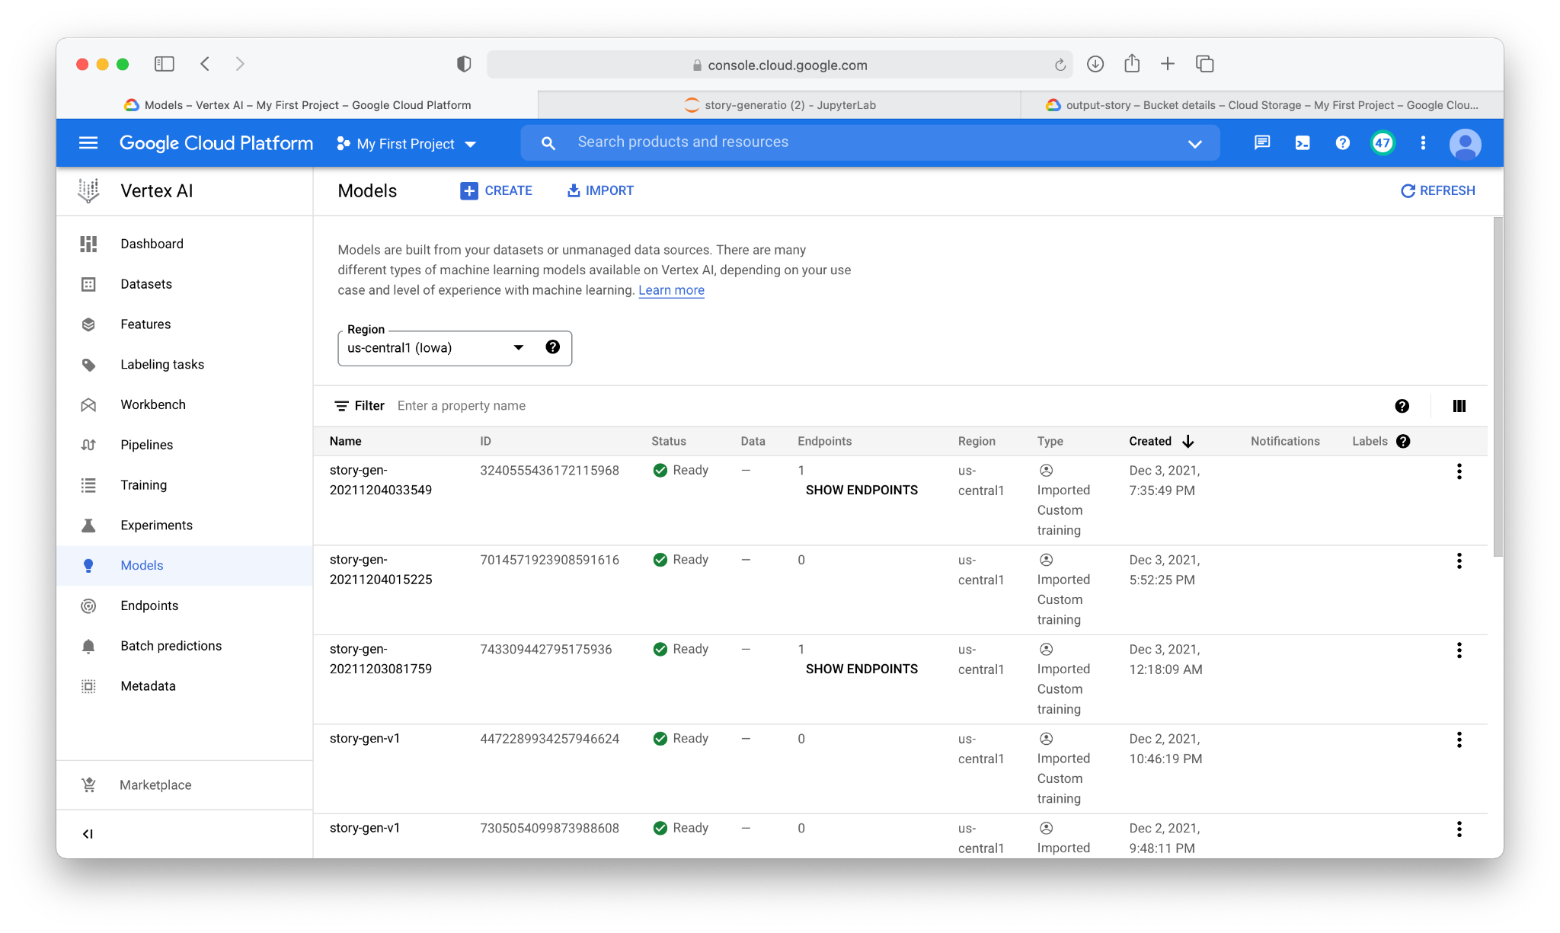
Deploy Model
Deploy model to the vertexAI.

Slide 9
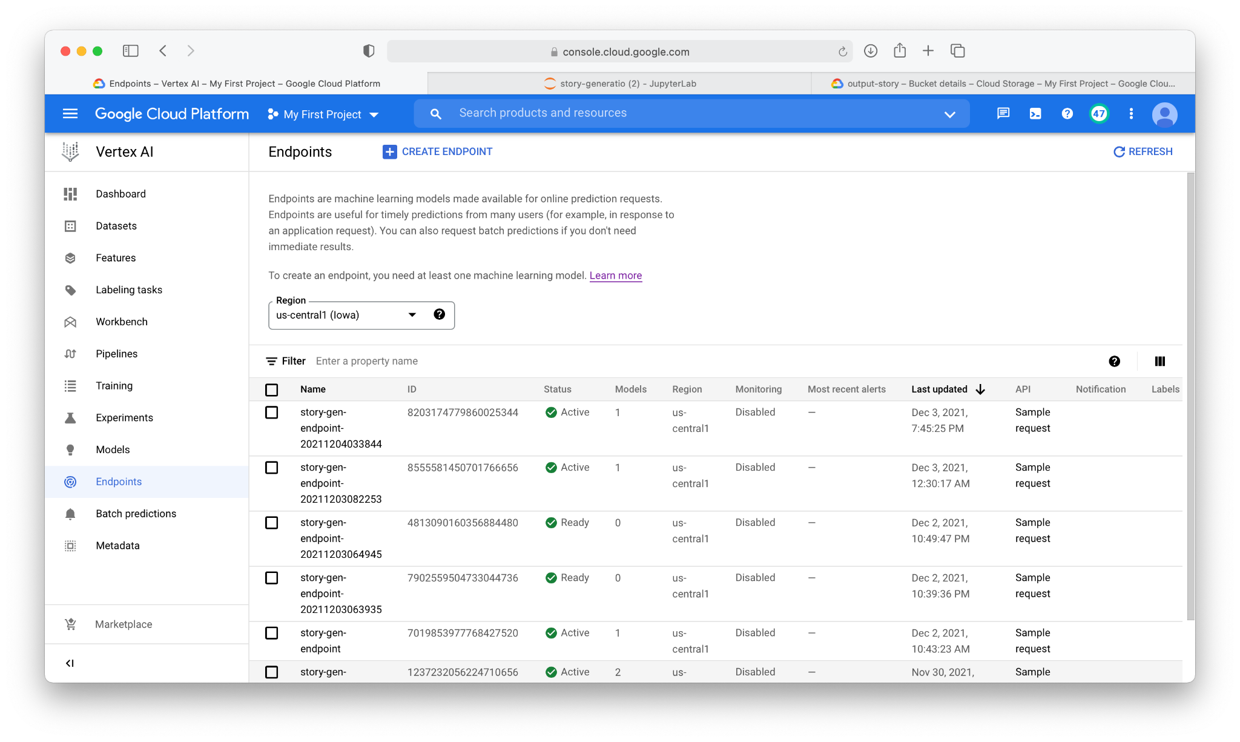
Endpoint
Create endpoint and deploy model to the endpoint.

Slide 10
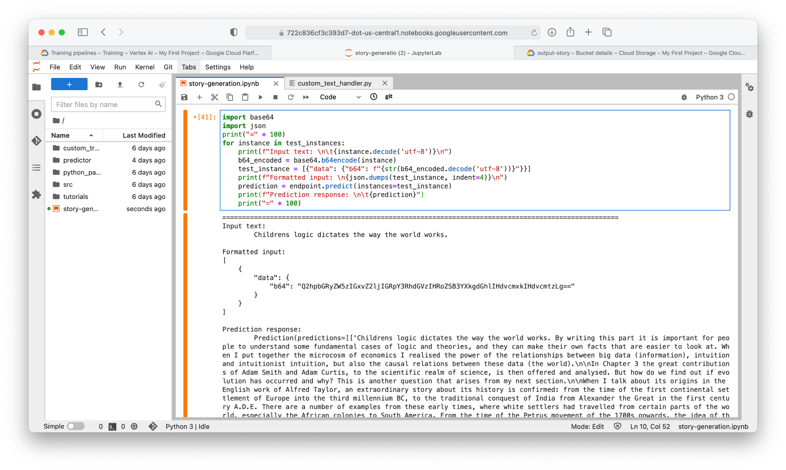
Inference
Inference on endpoint for generating the story with the given prompt

Slide 11
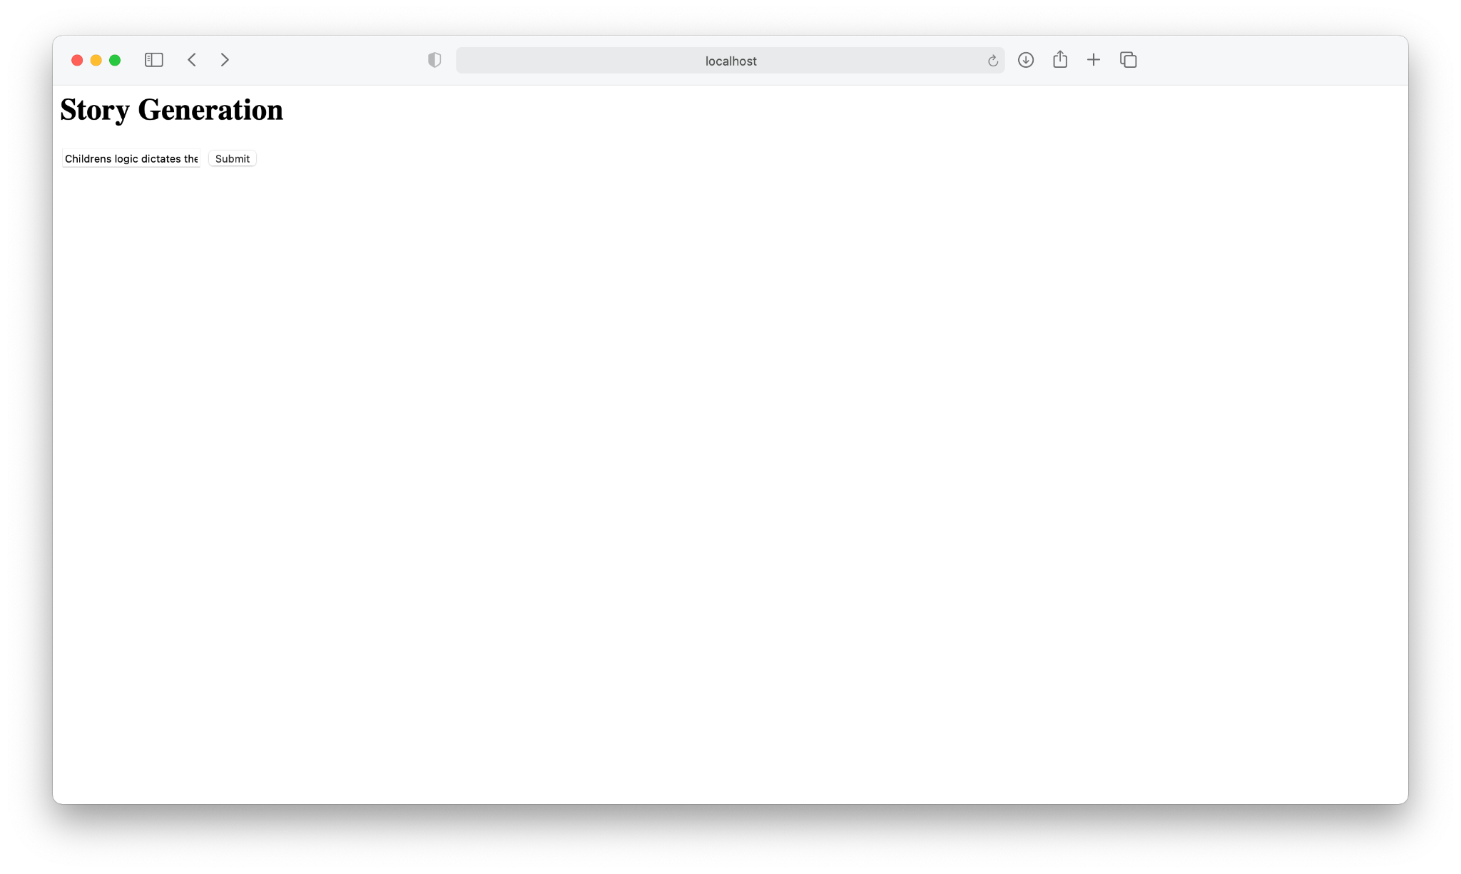
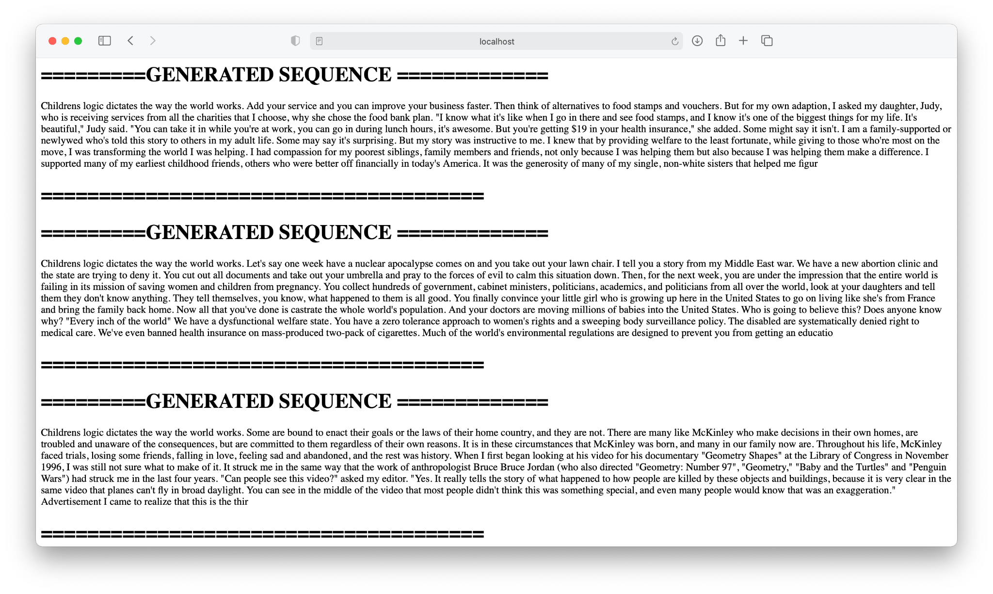
Flask Web application

Slide 12
THANK YOU

